Slide 1

Intuitive Situational Awareness
A Military Use Case
Joetta Kreck
Enterprise Support Branch
Email: Joetta.l.kreck@usace.army.mil
Phone: (703) 428-3903
Date: 1 March 2022

Slide 2
Summary
Motivation: soldiers can benefit from feature data with basic attribution that is intuitively symbolized, easily updated and requires minimal data storage and/or bandwidth to transmit.
Related use cases:
POI for route planning
Roles:
Consumer – a soldier or mission support personnel using mounted, mobile, operations center systems
Geospatial Consumer System Developer – developer of mounted, mobile and operations systems that are not geospatially focused
Producer – a soldier or other mission support personnel using GIS based systems
Geospatial Producer System Developer – developer of systems with robust geospatial capability for geospatial data production and analysis
Devices:
Mounted, Mobile, Desktop and Server based systems using Services, Caches and Packaged Datasets.

Slide 3
Use Case: Situational Awareness
POI for Situational Awareness
A Point of Interest (POI) can be described in a variety of ways, for this military situation awareness use case, POIs are a simplified set of point features that the user community needs visually represented with options to search, filter, and view labels and attributes. POIs are derived from a more complex geospatial data model and simplified to better enable systems with limited geospatial capabilities. While traditional feature data carries attributes that are often null or contain a “no information” value, POIs should only carry the most relevant and well populated information. In addition to traditional attributes the POI will contains 3 pre-calculate fields that can simplify search, filter, categorize and symbolize the POIs.
POI for Data Collection
POIs, when combined with an identified symbol set, play a key role in enabling end user data collection. An end user with a known symbol set loaded on a device and a capability to select the icon and place it on the map can perform data collection in the field. The end user may also select the collected symbol and fill form fields with additional details. The collected data may be encrypted and stored on the device, shared across the network, or pushed to the server when connectivity is available.

Slide 4
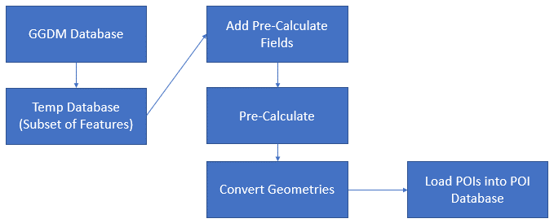
POI Simplification of Sample Dataset
TopoPOI - Simple
POIs within GGDM
POI Symbol Name (SO_ID) | Feature Count
Feature Class/Table: POI | 621
airport | 7
bank | 32
communications_tower | 10
dam | 7
fire_dept | 19
fuel | 62
general_cemetery | 12
helipad | 6
hospital_clinic | 17
hotel | 8
market | 42
park | 33
police_station | 13
post_office | 9
power_station | 1
power_substation | 12
prison | 2
school | 7
sewage_treatment | 1
stadium | 2
sports_ground | 5
water_tower | 22
wrshp_buddhist | 2
wrshp_christian | 274
wrshp_general | 16
Feature Class/Table | Number of Features | Feature (count)
AeronauticPnt | 13 | Land Aerodrome (6), Helipad (6)
CulturePnt | 45 | Cemetery (12), Interest Site (Placeholder for Park) (33)
UtilityInfrastructurePnt | 14 | Electric Power Station (1), Power Substation (12), Sewage Treatment Plant (1)
HydrographyPnt | 7 | Dam (7)
RecreationPnt | 7 | Stadium (2), Sports Ground (5)
StoragePnt | 22 | Water Tower (22)
StructurePnt | 451 | Building (441), Tower (10)
TransportationGroundPnt | 62 | Motor Vehicle Station (62)
A process to create a simplified POI dataset that is easier to symbolize and interpret

Slide 5
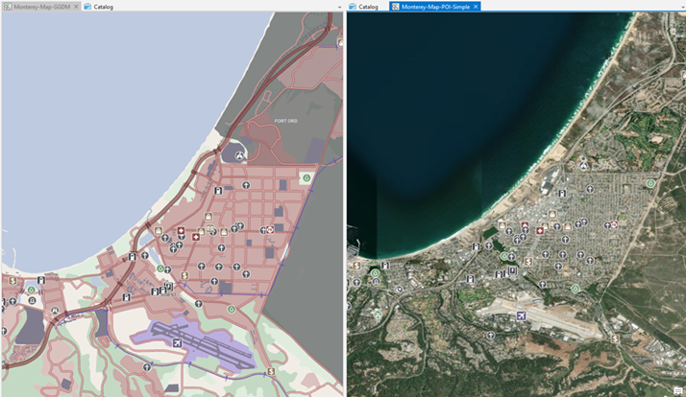
Prototype Concept
Pre-calculate Fields
LBL_VAL | A value that could be used for labeling such as a name or feature function. | String
SO_ID | Symbol name | String
SIMPLE_DESC | Simplified Description for categorization | String
Existing NAS Attributes
Descriptive Attributes
FFN, FFN2, FFN3 | Feature Function | Enumeration
ZI005_FNA | Geo Name Info : Full Name | String
ZI037_REL | Religious Information : Religious Designation | Enumeration
ZI037_RFA | Religious Information : Religious Site Type | Enumeration
TTC, TTC2, TTC3 | Tower Type | Enumeration
COS | Facility Operational Status | Enumeration
PCF | Physical Condition | Enumeration
HGT | Height Above Surface Level | Real
MFY | Medical Facility Type | Enumeration
MEL | Medical Service | Enumeration
ZI006_MEM | Note : Memorandum | String
FURL | External References | StructuredText
FUFI | Feature Unique Identifier | StructuredText
Metadata
ZI001_SDV | Source : Source Date and Time | StructuredText
ZI001_SRT | Source : Source Type | Enumeration
ZI004_RCG | Physical Object Metadata : Process Step Information : Resource Content Originator | Enumeration
ZSAX_RS0 | Restriction : Security <resource classification> | CodeList
ZSAX_RX0 | Restriction : Security <resource dissemination controls> | StructuredText
ZSAX_RX3 | Restriction : Security <resource non-intelligence community markings> | StructuredText
ZSAX_RX4 | Restriction : Security <resource owner-producer> | StructuredText
ZI002_UFI | Restriction Information : Unique Entity Identifier | StructuredText
GDBV | Geodatabase Schema Version | Enumeration

Slide 6
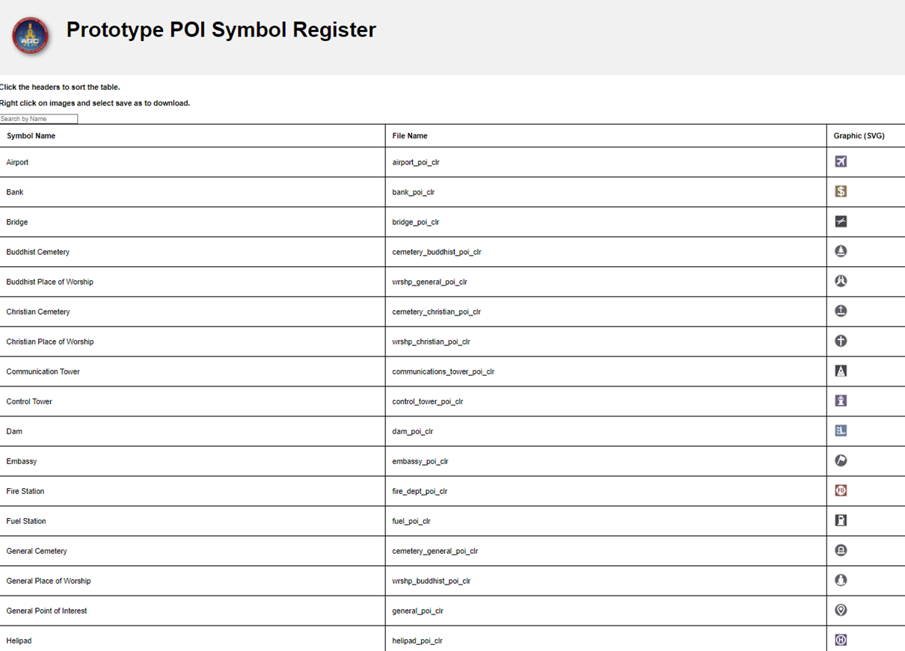

Slide 7
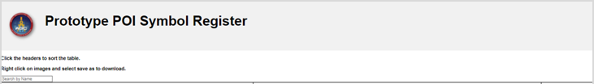
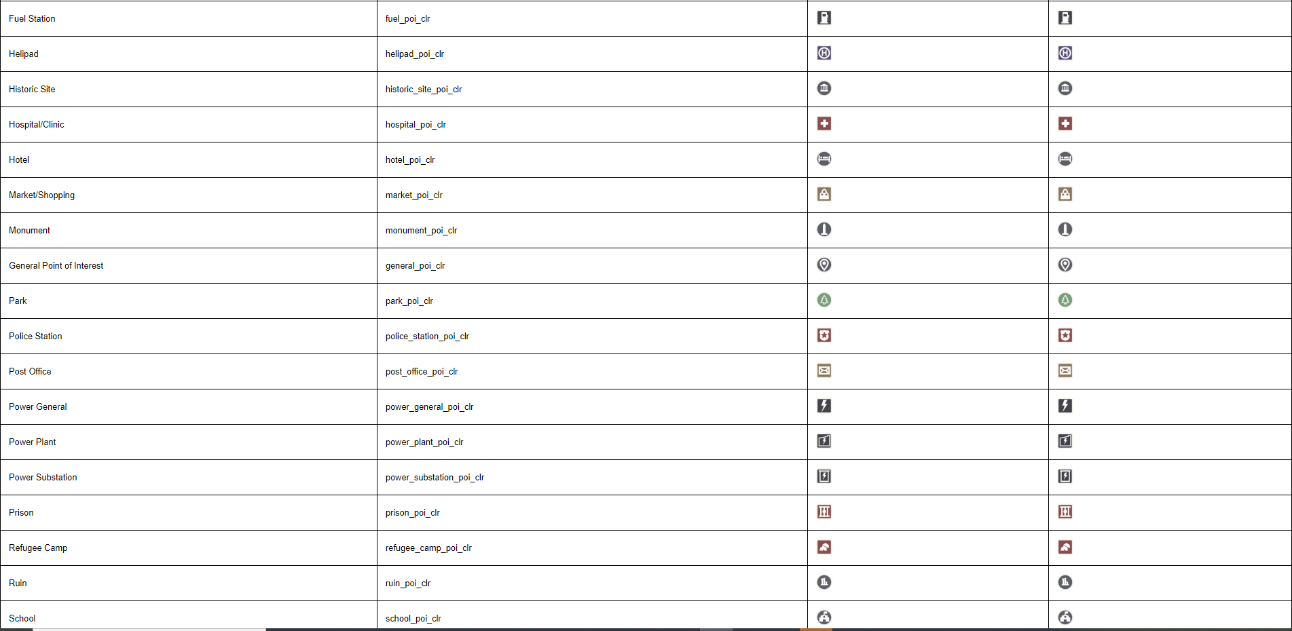


Slide 8
Use Case: Intuitive Situational Awareness/Understanding
Roll: Geospatial Producer (Geospatial Tech/Provisioner)
Geospatial Data
Preparation & Collection
Visualization
Portrayal and Details
Generating or Importing Data
What is needed?/What is interesting?
Locate POI sources
Get POI out of a complex data model
Processing
Cleaning/Filtering/Aggregating
Delivery
Services
Cache
Packages
Consumer Collected Data
Update with correction
Add new POIs
Pre-Process Data
Select subset from master model
Priority/Sort order for popups
Pre-calculated vs complex query
Metadata
Ensure appropriate Security Metadata
Populate/Package/Transmit Metadata
Populate Metadata
Apply Security Based Filtering
Symbols
Export/Package/Reference
Style Encoding
Export/Package/Reference

Slide 9
Use case: Intuitive Situational Awareness/Understanding
Role: Geospatial Producer System Developer
Geospatial Data
Preparation & Collection
Visualization
Portrayal and Details
Tools, Workflows, Best practices
POI Dataset Generation
Extricate POI from complex data models
Cleaning/Filtering/Aggregating
Metadata – Settings/Population and Export
Manage Default Security Settings
Populate/Package/Transmit Metadata
Permissions based Provisioning
Security Based Filtering
Style File Generation
Link data to Symbology
Simplified linking of data to symbols
Simplified linking labels to Data
Label – Pre-processing
Scale Based Filtering
Prioritization of popup displayed attributes
Rendering Order
POI Service with style options
Toggle – All, Sub Group, Single Type, Label
Filter – Type
Select and Expand popup
Change Style
Import Style
Share Style - Export/Package/Reference

Slide 10
Use case: Intuitive Situational Awareness/Understanding
Role: Geospatial Consumer System Developer
Geospatial Data
Preparation & Collection
Visualization
Portrayal and Details
Data
Connect to Service/Load Data
Link Symbols to data.
Link attributes to pop-ups
Link attributes to domain value lookups
Collection
Drop symbol on map - link Symbol to default attribute set
Form Option:
Collect from a list of pre-defined attributes (drop downs associated with domain lookup tables)
Free text to notes field
Add photo hyperlink
Read and Apply Style File
Link data to Symbology
Apply labels to Data
Scale Based Filtering
Prioritization of popup displayed attributes
Rendering Order
Load/Cache/Read Symbol Graphics
Enable Search and Filter
Cluster and Filter Symbols

Slide 11
Use case: Intuitive Situational Awareness/Understanding
Role: Geospatial Consumer
Geospatial Data
Preparation & Collection
Visualization
Portrayal and Details
Obtain Data
Connect to Service – Cache Data
Download Packaged Data
Collect / Update Data
Collect New POI
Flag for correction
Details(Attributes)
Use POIs for:
General Position Verification – (Where am I? Am I where I think I am?)
POI as a start point and end point (routing and general planning)
Toggle – All, Sub Group, Single Type
Filter – Type
Toggle - Labels
Select Information
Import Style
Change Style

